Slide 1
ALOSIUS R
Final Project
3/21/2024 Annual Review

Slide 2
PROJECT TITLE:
HANDWRITTEN DIGIT RECOGNITION USING GENERATIVE ADVERSIALNETWORK
3/21/2024 Annual Review

Slide 3


AGENDA
GAN-based Handwritten Digit Recognition
1. Overview
Goal: Recognize digits using GANs.
Dataset: MNIST.
2. Data Preparation
Normalize and reshape images.
3. GAN Structure
Generator: Creates digit images.
Discriminator: Classifies real/fake.
4. Training & Evaluation
Adversarial learning.
Measure accuracy, precision, etc.
5. Optimization
Fine-tune for better results.
Apply regularization to prevent overfitting.
6. Deployment
Prepare model for production.
Create basic UI for testing.
7. Reporting & Conclusion
Document process and results.
Summarize outcomes and next steps.
3/21/2024 Annual Review

Slide 4

PROBLEM STATEMENT:
Problem Statement for Handwritten Digit Recognition Using GANs
Digit Recognition Challenge
Handwritten digit recognition presents a challenge due to the variability in writing styles, shapes, and orientations. Models must accurately classify digits across a diverse set of samples.
Need for GAN-based Models
Traditional classification models can struggle with limited or skewed datasets. Generative Adversarial Networks (GANs) offer a unique approach, allowing for the generation of realistic digit samples to enhance training and improve model robustness.
High Accuracy Requirements
The goal is to achieve high accuracy in digit recognition, ensuring the model performs well across all digit classes (0-9). Precision and recall are critical to ensure reliable predictions in real-world applications.
Preventing Overfitting and Underfitting
Overfitting on training data is a common issue, especially with deep learning models. The problem is to design a GAN-based solution that balances learning without excessive generalization or underfitting, thus maintaining performance on unseen data.
3/21/2024 Annual Review

Slide 5

PROJECT OVERVIEW:
Project Overview: Handwritten Digit Recognition Using GANs
This project aims to develop a Generative Adversarial Network (GAN) for recognizing
handwritten digits, focusing on high accuracy and robustness.
Using the MNIST dataset, we will traina GAN with a generator that creates realistic digit images and a
discriminator that distinguishes betweenreal and synthetic images.
The key goals are to build a model that can accurately classify digits 0-9, optimize the architecture to
prevent overfitting, and ensure reliable performance on unseen data.
After training and evaluation, we plan to deploy the model with a user-friendly interface for digit recognition tasks,
along with comprehensive project documentation and future improvement recommendations.
3/21/2024 Annual Review

Slide 6

WHO ARE THE END USERS?
Developers and Engineers
Software developers and engineers who build applications requiring digit recognition capabilities. They can integrate the trained model into their software projects or use it to automate tasks involving handwritten digit input.
Data Scientists and Machine Learning Practitioners
Data scientists and ML practitioners interested in GAN-based applications for image generation and classification. They can use the project as a reference for building similar models or for educational purposes.
Educational Institutions
Schools, colleges, and universities with computer science or data science programs. This project can serve as a teaching tool for understanding GANs and their application in image recognition tasks.
Businesses and Enterprises
Companies that need automated systems for processing handwritten data, such as forms, checks, or other digit-based information. They can deploy the digit recognition model to improve efficiency and accuracy in data processing workflows.
3/21/2024 Annual Review

Slide 7

YOUR SOLUTION AND ITS VALUE PROPOSITION
Improved Accuracy and Robustness: By utilizing a GAN-based approach, the solution aims to achieve higher accuracy in recognizing handwritten digits compared to traditional models. The adversarial training process allows for continuous improvement, leading to a robust model that can handle varied handwriting styles.
Enhanced Data Augmentation: The GAN's generator can create synthetic digit images, providing a valuable resource for data augmentation. This helps prevent overfitting and ensures the model remains effective across a wide range of handwritten digit variations.
Versatile Use Cases: The solution can be applied to various industries and scenarios where handwritten digit recognition is required, such as banking, education, data entry, and form processing. This versatility makes the project valuable to a broad range of users and businesses.
Efficient Deployment: The project aims to provide an efficient and easy-to-use model for deployment in real-world applications. This includes integrating the trained model into software systems and offering a user-friendly interface for end-users, ensuring smooth adoption and usability.
3/21/2024 Annual Review

Slide 8

THE WOW IN YOUR SOLUTION:
GAN's Innovative Approach Using Generative Adversarial Networks (GANs) for handwritten digit recognition brings a unique adversarial learning process, where a generator creates realistic digit-like images while a discriminator distinguishes real from fake. This approach drives continuous improvement, resulting in a high-performing model.
Synthetic Data for Robustness The GAN's ability to generate synthetic handwritten digit images boosts data augmentation, leading to greater model robustness. This ensures the model can handle a wide range of handwriting styles and unpredictable variations.
Exceptional Accuracy and Precision The GAN-based model aims for top-notch accuracy, precision, and recall, thanks to the adversarial learning process. This high accuracy is crucial for applications where even minor errors could have significant consequences
3/21/2024 Annual Review

Slide 9
MODELLING
GAN Structure: A generator creates realistic digit images, while a discriminator distinguishes real from generated. The two networks train together in an adversarial manner, pushing each other to improve.
Training: Use the MNIST dataset to train the generator to produce convincing digits and the discriminator to identify real and fake images. The goal is for the generator to fool the discriminator.
Hyperparameters: Adjust batch size, learning rate, and number of epochs to optimize training. Typical learning rates are between 0.0001 and 0.001.
Evaluation: Test the model on a validation set from MNIST, checking metrics like accuracy, precision, and recall. This ensures the discriminator's accuracy and the generator's ability to produce convincing images.
Optimization: Apply regularization (like dropout) to avoid overfitting. Fine-tune hyperparameters for optimal model performance.
3/21/2024 Annual Review

Slide 10
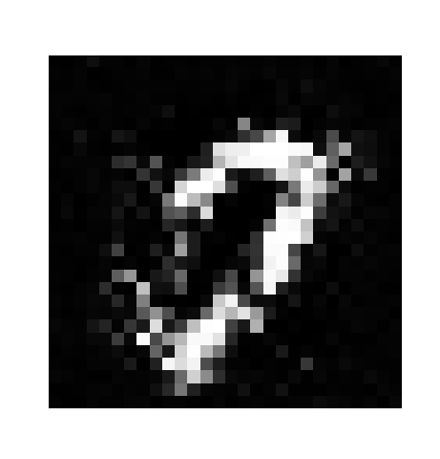
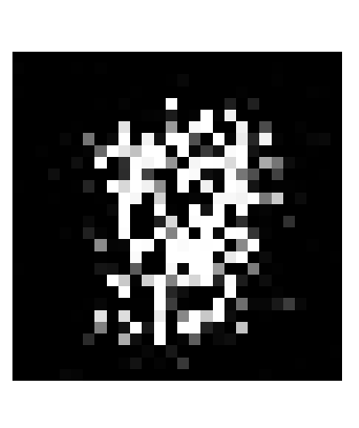
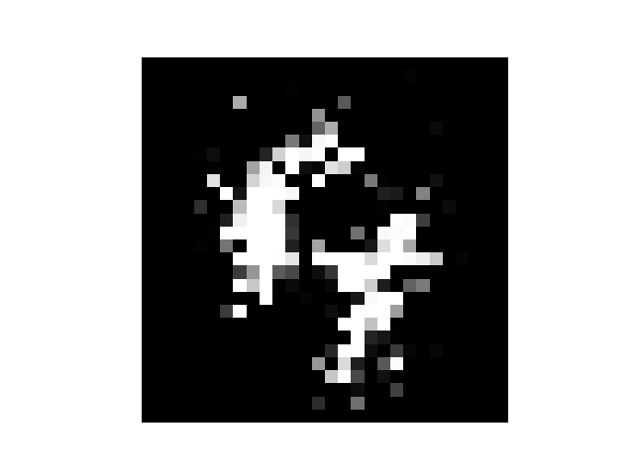
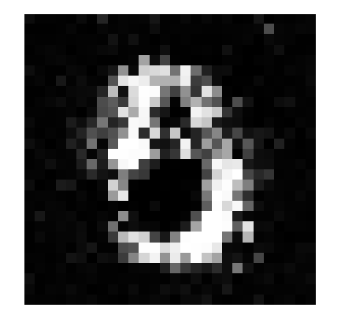
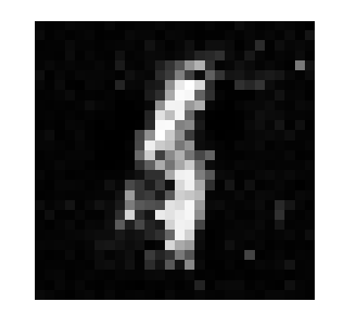
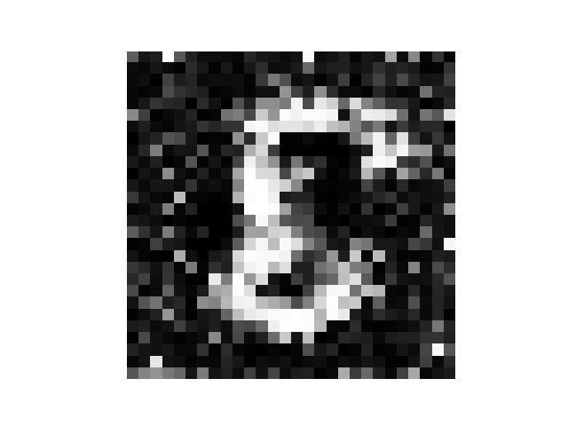
RESULTS
Demo ink
3/21/2024 Annual Review

